Slide 1

Robot programming
Lorenzo Natale, Ali Paikan, Alessandro Roncone, Ugo Pattacini, Daniele Domenichelli
iCub Facility
Istituto Italiano di Tecnologia, Genova
Genova, July 2015

Slide 2
Program
2nd July, 2015 – h 10:12 – Sala Natta - Lesson 1: Introduction to the middleware
3nd July, 2015 – h 10:12 – Sala Volta - Lesson 2: Hello world, command line tools. YARP threads and YARP modules
6nd July, 2015 – h 10:12 – Sala Natta - Lesson 3: YARP Manager, port monitor, and realtime computing with YARP
7nd July, 2015 – h 14:16 – Sala Dulbecco - Lesson 4: Image processing and Computer Vision
8nd July, 2015 – h 14:16 – Sala Dulbecco - Lesson 5: The Gaze controller and the Cartesian Controller for efficient inverse kinematics
10nd July, 2015 – h 14:16 – Sala Dulbecco - Lesson 6: Software development with GIT, the GIT workflow

Slide 3
References
YARP: www.yarp.it
Documentation
Papers (see also references in this presentation)
iCub: http://wiki.icub.org/wiki/Manual
CMake:
www.cmake.org → documentation & wiki
Mastering CMake, by Kitware Inc.
C++:
Thinking in C++, Bruce Eckel
The C++ programming language, Bijarne Stroustrup
Anything else

Slide 4


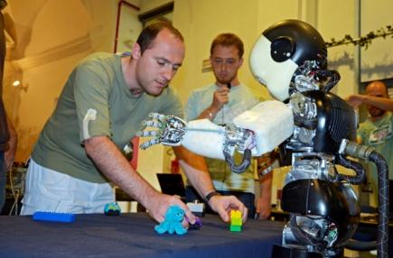
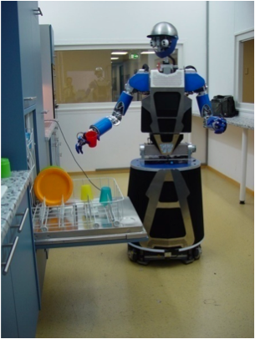
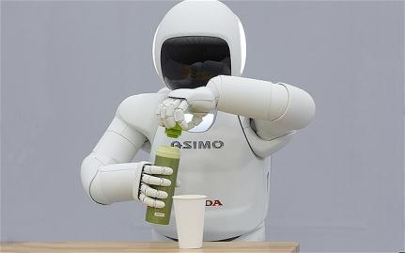
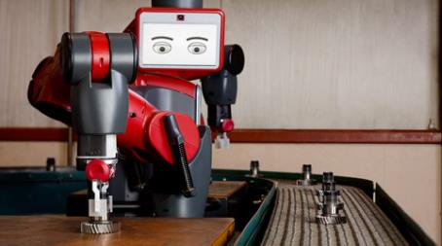
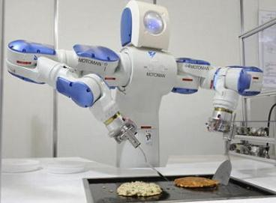
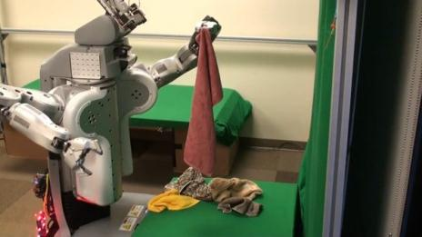
Motivations

Slide 5
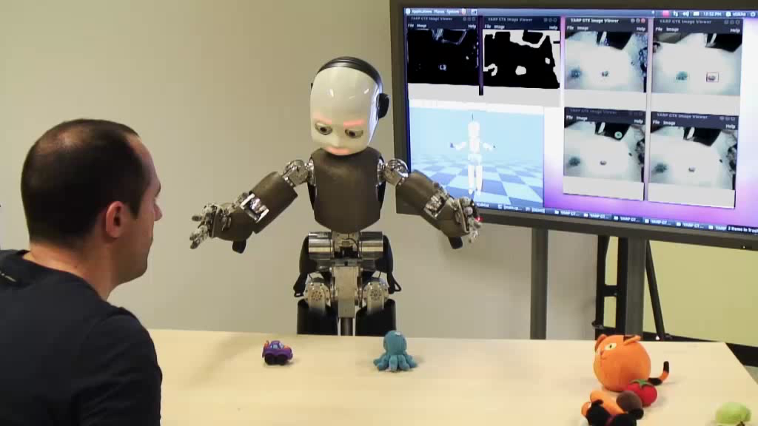
Complex behaviors

Slide 6
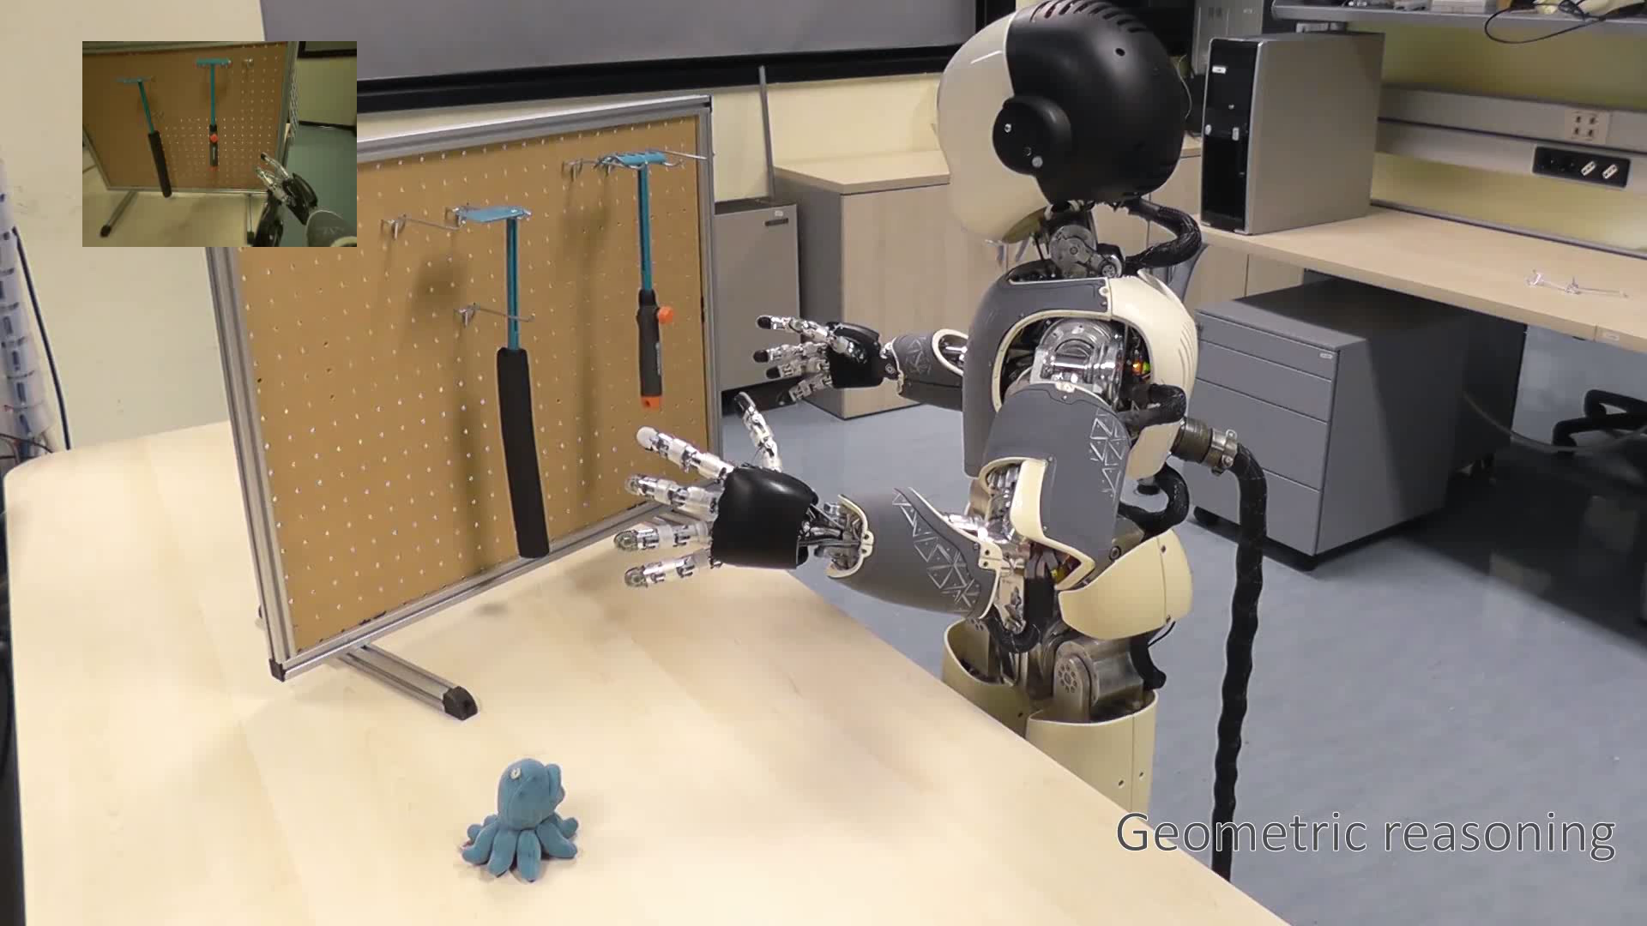
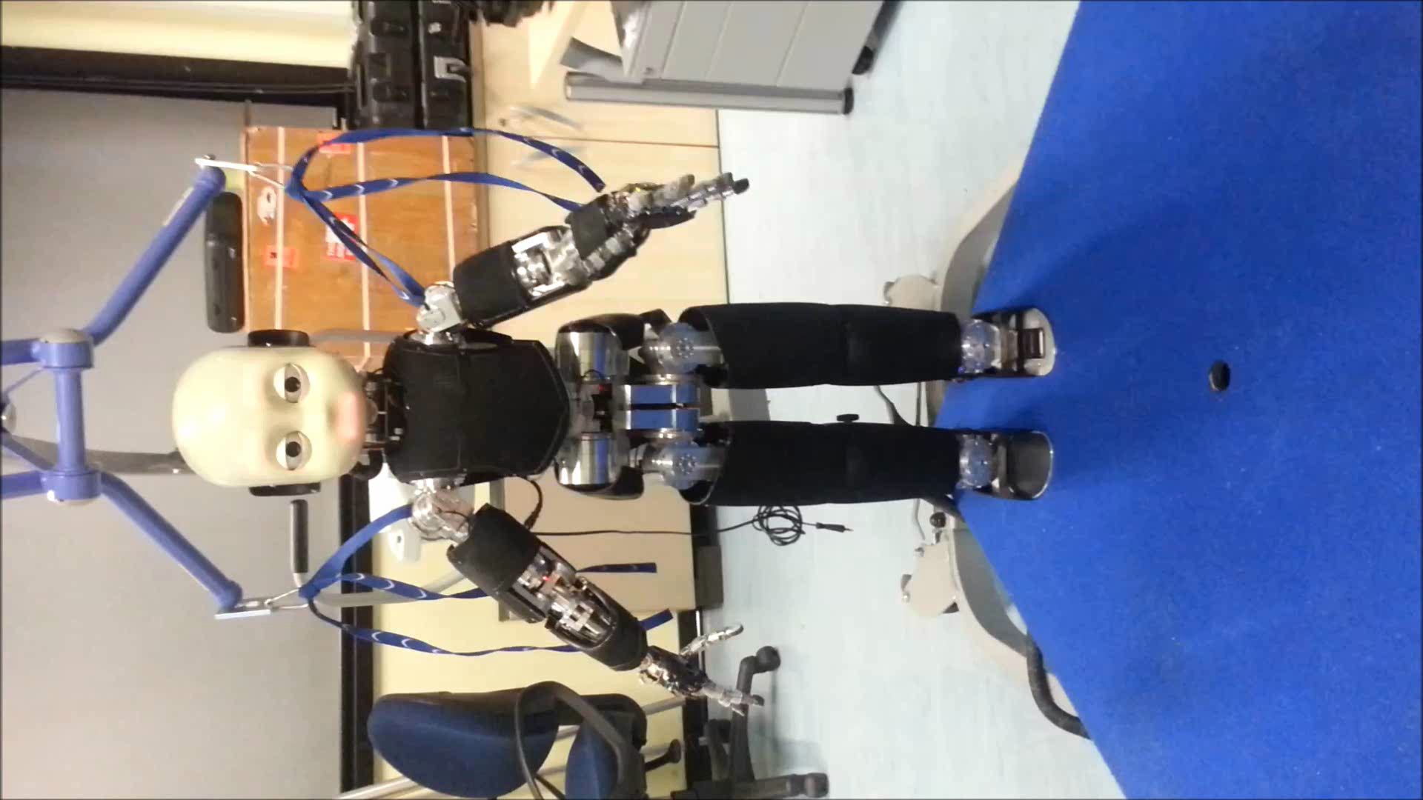
Integration of software components

Slide 7
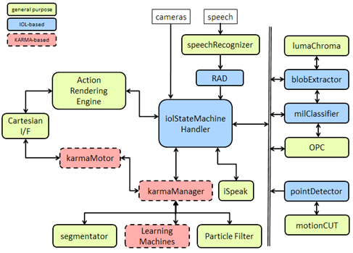
Complex behaviors

Slide 8
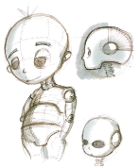
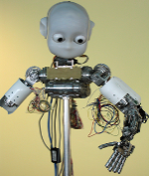
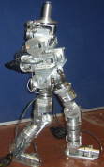
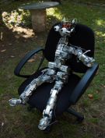
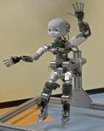
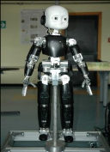
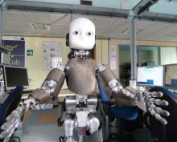

Key issues
Asynchronous development
Variability: various scenarios and platforms
Lack of standards
Inherent complexity, distributed processing, lots of sensors, real-time
Fluctuation in hardware and algorithms, lots of open questions

Slide 9
Software architecture
Major cost in software development is debugging, recycling code is key
Divide and conquer
Modularity
Factor out platform specificities
Hardware Abstraction Layer
Communication Abstraction
Operating system
Parameters
Computing infrastructure

Slide 10

Separation of concerns (5C)
Goal: separate software components
Computation
Communication
Configuration
Coordination
Composition
What we are interested in
Dependent on the hardware, network topology
Application dependent
BRICS Component Model, 2013

Slide 11
Component driven software development
output myAlgorithm(input)
{
...
out = call alg1(in)
…
out = call alg2(in)
getImage() // from usb camera
…
}
output alg1(input)
{code}
output alg2(input)
{code}

Slide 12
Component driven software development
output myAlgorithm(input)
{
...
out = call alg1(in)
…
out = call alg2(in)
getImage() // from usb camera
…
}
output alg1(input)
{code}
output alg2(input)
{code}
Program1
myAlg()
middleware
hardware
Program2
Program2
middleware
middleware
alg1()
alg2()

Slide 13
Component driven software development
output myAlgorithm(input)
{
...
out = call alg1(in)
…
out = call alg2(in)
getImage() // from usb camera
…
}
output alg1(input)
{code}
output alg2(input)
{code}
Program1
myAlg()
middleware
hardware
Program2
Program2
middleware
middleware
alg1()
alg2()

Slide 14
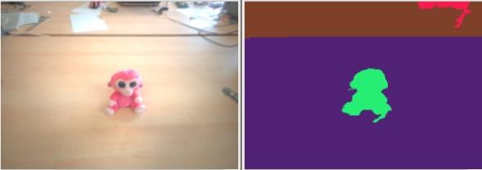
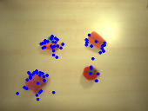


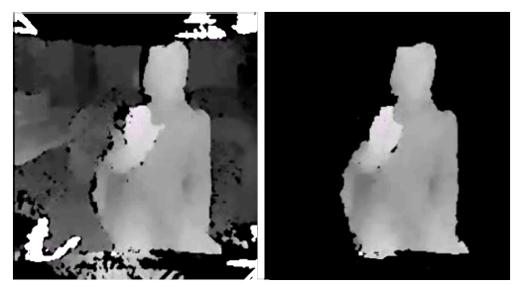
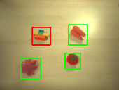
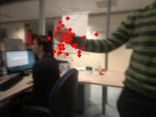
Components: some examples from the iCub repository
Algorithms for motion computation and egomotion compensation
Machine learning for vision
Disparity map
Action recognition
Segmentation
See https://github.com/robotology

Slide 15
Component driven development
Modular software: simple structure, data encapsulation, interface
Reconfigurable components
Reduced coupling: interaction between components happens through pre-defined standards (no direct inclusion of header files)

Slide 16
Communication paradigm
Publish/Subscribe
Space, time, synchronization decoupling
Remote Procedure Calls (RPC)
Remote invocation of object
Synchronous nature (although variant exists)

Slide 17
Publish/Subscribe
Space decoupling: the interaction parties do not need to know each other; publisher publish events through an event service and the subscribers get these events indirectly through the event service
Time decoupling: interaction parties do not need to be actively participating in the interaction at the same time, publisher might publish events while subscribers is disconnected and subscribers might get notified of an event while the original publisher is disconnected
Synchronization decoupling: publishers are not blocked while producing events and subscribers can get asynchronously notified (through callback) of the occurrence of the event while performing concurrent activity
Eugster, et al., The Many Faces of Publish/Subscribe, 2003.

Slide 18
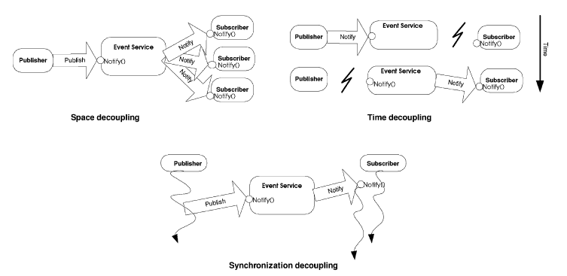
From: Eugster, et al., The Many Faces of Publish/Subscribe, 2003.

Slide 19
YARP approach
Limited form of publish-subscribe
Observer patter: subscribers register their interest directly with publishers, which mange subscriptions and sends events
Publishers notify subscribers synchronously or asynchronously
Space decoupling (from user perspective)
Time coupling
Dynamic (re)configuration
See also:
YARP: Yet Another Robot Platform, G. Metta, P. Fitzpatrick, L. Natale, 2006
Stewart et al., Design of Dynamically Reconfigurable Real-time Software Using Port-Based Objects, 1997

Slide 20
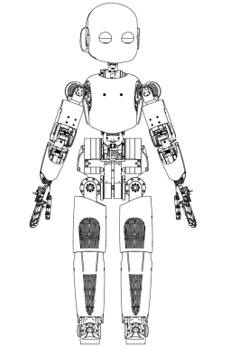
iCub software architecture
/camera
/arm/encs
/arm/trqs
ROBOT
/hand/touch
…
/arm/cmd

Slide 21
iCub software architecture
Object det.
...
...
Reaching
/camera
/arm/encs
...
...
/arm/trqs
ROBOT
...
/hand/touch
...
...
…
/arm/cmd
Grasping
...
...
...

Slide 22
iCub software architecture
Object det.
...
...
Reaching
/camera
/arm/encs
...
...
/arm/trqs
ROBOT
...
/hand/touch
...
...
…
/arm/cmd
Grasping
...
...
...

Slide 23
iCub software architecture
Object det.
...
...
Reaching
/camera
/arm/encs
...
...
/arm/trqs
ROBOT
...
/hand/touch
...
...
…
/arm/cmd
Grasping
...
...
...

Slide 24
iCub software architecture
Object det..
...
...
Reaching
/camera
/arm/encs
...
...
/arm/trqs
ROBOT
...
/hand/touch
...
...
…
/arm/cmd
Grasping
...
...
...

Slide 25
iCub software architecture
Object det..
...
...
Reaching
/camera
/arm/encs
...
...
/arm/trqs
ROBOT
...
/hand/touch
...
...
…
/arm/cmd
Grasping
...
Viewer
...
...
...

Slide 26
iCub software architecture
Object det..
...
...
Reaching
/camera
/arm/encs
...
...
/arm/trqs
ROBOT
...
/hand/touch
...
...
…
/arm/cmd
Grasping
...
Viewer
...
...
...

Slide 27
iCub software architecture
mcast
Object det..
...
udp
...
Reaching
/camera
udp
/arm/encs
...
udp
...
/arm/trqs
ROBOT
mcast
...
/hand/touch
...
...
…
udp
/arm/cmd
Grasping
...
udp
udp
Viewer
...
...
...

Slide 28
iCub software architecture
mcast
Object det..
...
udp
...
Reaching
/camera
udp
/arm/encs
...
udp
...
/arm/trqs
ROBOT
mcast
...
/hand/touch
...
...
…
udp
/arm/cmd
Grasping
...
udp
udp
Viewer
...
...
...

Slide 29



YARP: main features
Peer-to-peer, loosely coupled, communication
Very stable code base >10 years old
Flexibility and minimal dependencies, fits well with other systems
Easy install with binaries on many OSes/distributions (Ubuntu, Debian, Windows, MacOs
Recently added: channel prioritization with QoS and thread priorities
Many protocols:
Built-in: tcp/udp/mcast
Plug-ins: ROS tcp, xml rpc, mjpg etc..

Slide 30
Interfaces
Define interfaces to motors and sensors so to minimize the impact of changes in the hardware
Also: network stubs allow remotization

Slide 31
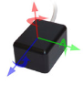
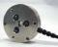
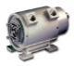
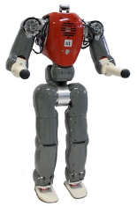
Interfaces
External loops
Network Stub
Robot Interface
Network
…
…
read encoders
read IMU
read FT
…
get image
...
set position
.
Network Stub
Robot Interface
Loops on board
…
…
read encoders
read IMU
read FT
…
get image
...
set position
Robot

Slide 32
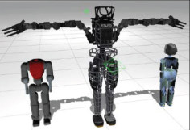
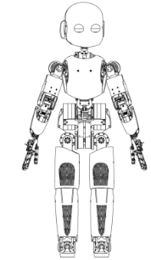
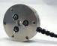
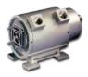
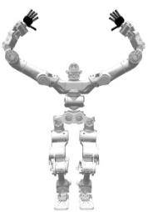
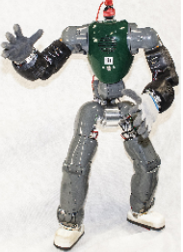
Interfaces
Control loops
…
…
read encoders
read IMU
read FT
…
get image
...
set position
Gazebo
Robot Interface
iCub
Recycle code across different robots and simulators (testing/fast prototyping)
Walkman
COMAN

Slide 33
YARP plugins
YARP includes a plugin system for drivers and protocols (carriers)
Interchangeable carriers allow:
interfacing existing software with ports (without bridges)
change significantly port behavior
Examples:
ROS, mjpeg, xml rpc, etc…
bayer carrier, priority based communication

Slide 34
Examples
Bayer Camera
/camera
YARP
receiver
yarp connect /camera /receiver rec.bayer

Slide 35
Examples
Bayer Camera
/camera
YARP
receiver
yarp connect /camera /receiver rec.bayer
MJPG camera
YARP
receiver
http://65.52.88.202:5159
yarp connect /65.52.88.202:5159 /receiver mjpeg

Slide 36
Examples
Bayer Camera
/camera
YARP
receiver
yarp connect /camera /receiver rec.bayer
MJPG camera
YARP
receiver
http://65.52.88.202:5159
yarp connect /65.52.88.202:5159 /receiver mjpeg
ROS
Node: /camera
Topic: /image
YARP
receiver
yarp connect /image@/camera /receiver
Camera.msg

Slide 37


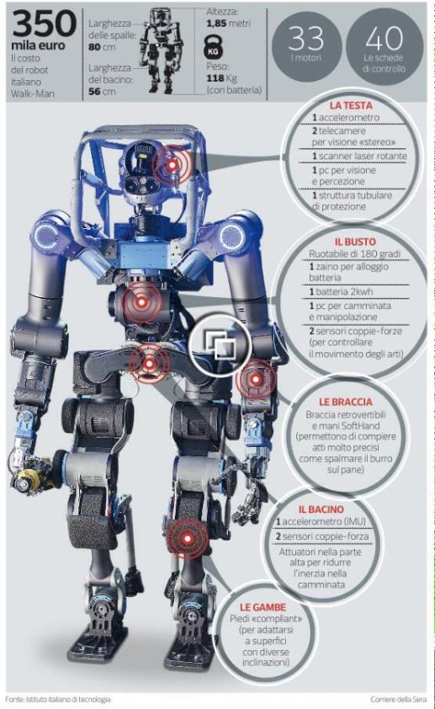


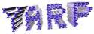
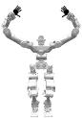
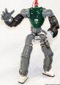


Success story
Manipulation
Modules
Pilot
Interface
Whole-Body Modules
RobotInterface
Locomotion
Module
Footstep &
Trajectory Planners
Walkman
Coman
Perception

Slide 38
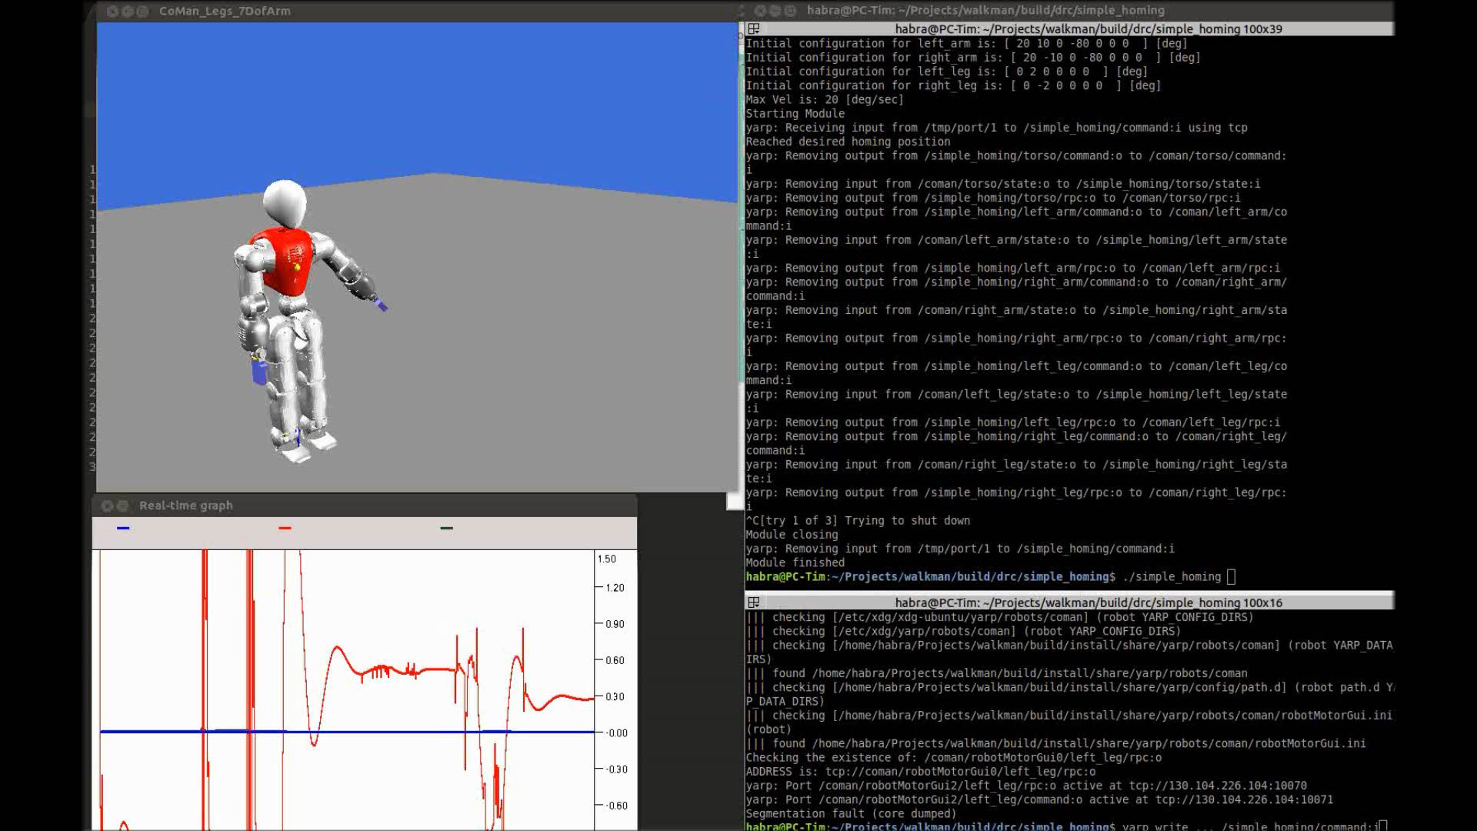
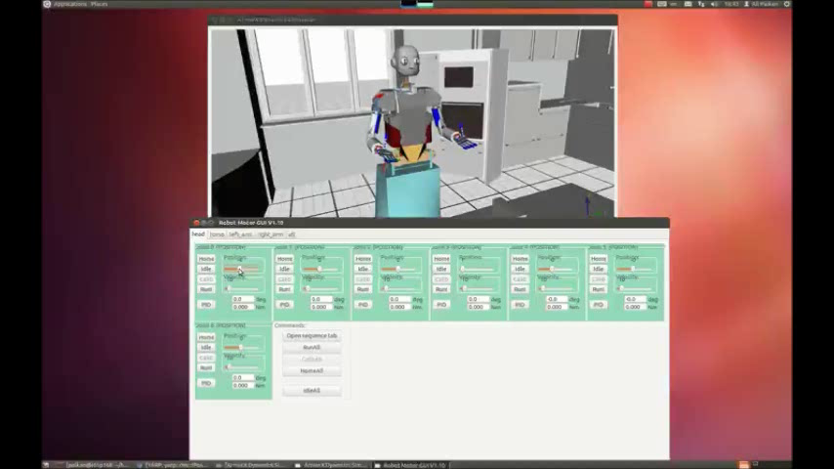
Simulators & robots
iCub, COMAN, Walk-man, ARMAR III
iCub_SIM (in the iCub main repository)
Gazebo (https://github.com/robotology/gazebo-yarp-plugins)
Robotran
Robotran-Yarp interface: a framework for real-time controller development based on multibody dynamics simulation, T. Habra, et al., 2015
Paikan et al., Transferring Object Grasping Skills and Knowledge Across Different Robotic Platforms, ICAR 2015

Slide 39

Managing complexity
In a modular system integration becomes an issue:
Execution and monitoring
Development
Coordination

Slide 40
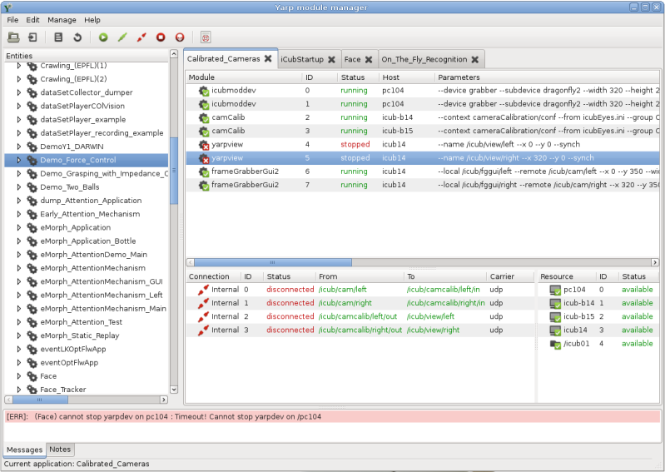



Execution and monitoring: YARP manager
Required
modules connections
nodes
resources
Available resources

Slide 41
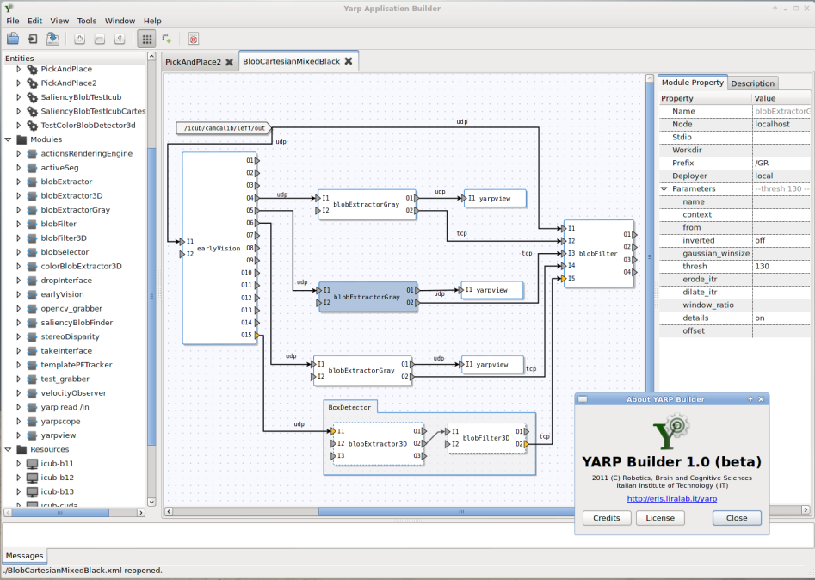
Tools for rapid development
YARP builder: graphical tool to design application
Interface Definition Language (IDL):
formalization of types and interfaces between modules
automatic generation of message handlers

Slide 42

Coordinating modules

Slide 43
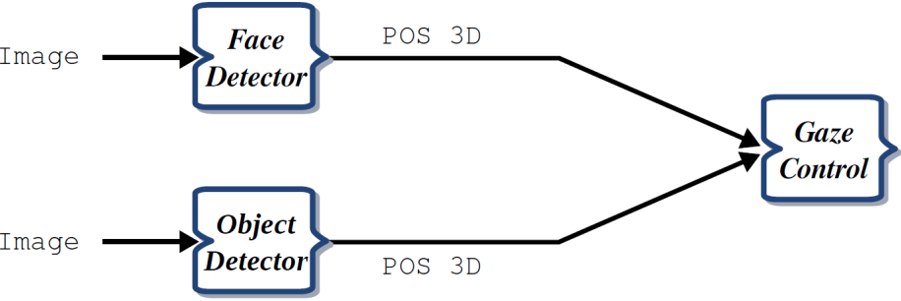
Arbitration and coordination
Paikan, A., et. al., Data Flow Port's Monitoring and Arbitration, Joser 2014.

Slide 44
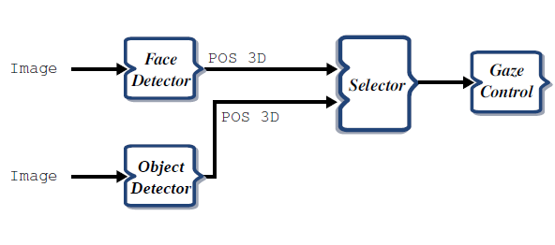
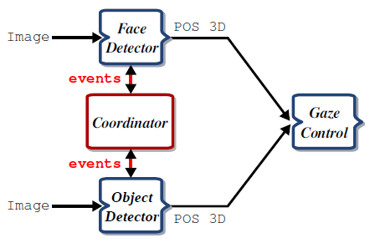
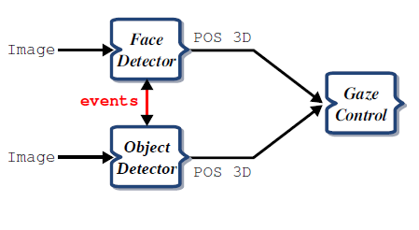
Arbitration and coordination

Slide 45
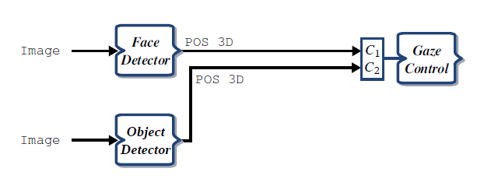
Our solution: Port Monitor

Slide 46
Our solution: Port Monitor

Slide 47
Our solution: Port Monitor
arbitration
if (C1.certainty > 0.9)
accept(C1)
else
accept(C2)

Slide 48
Our solution: Port Monitor
arbitration
if (C1.certainty > 0.9)
accept(C1)
else
accept(C2)
if (check(C1)
dispatch(event)
coordination

Slide 49
Our solution: Port Monitor
arbitration
if (C1.certainty > 0.9)
accept(C1)
else
accept(C2)
if (check(C1)
dispatch(event)
C1=filter(C1)
coordination
filtering

Slide 50
Our solution: Port Monitor
arbitration
if (C1.certainty > 0.9)
accept(C1)
else
accept(C2)
if (check(C1)
dispatch(event)
C1=filter(C1)
dispatch(C1)
coordination
filtering
logging

Slide 51
Our solution: Port Monitor
arbitration
if (C1.certainty > 0.9)
accept(C1)
else
accept(C2)
if (check(C1)
dispatch(event)
C1=filter(C1)
dispatch(C1)
If (C1)
T1=getTime()
coordination
filtering
logging
Monitoring delays, QoS

Slide 52
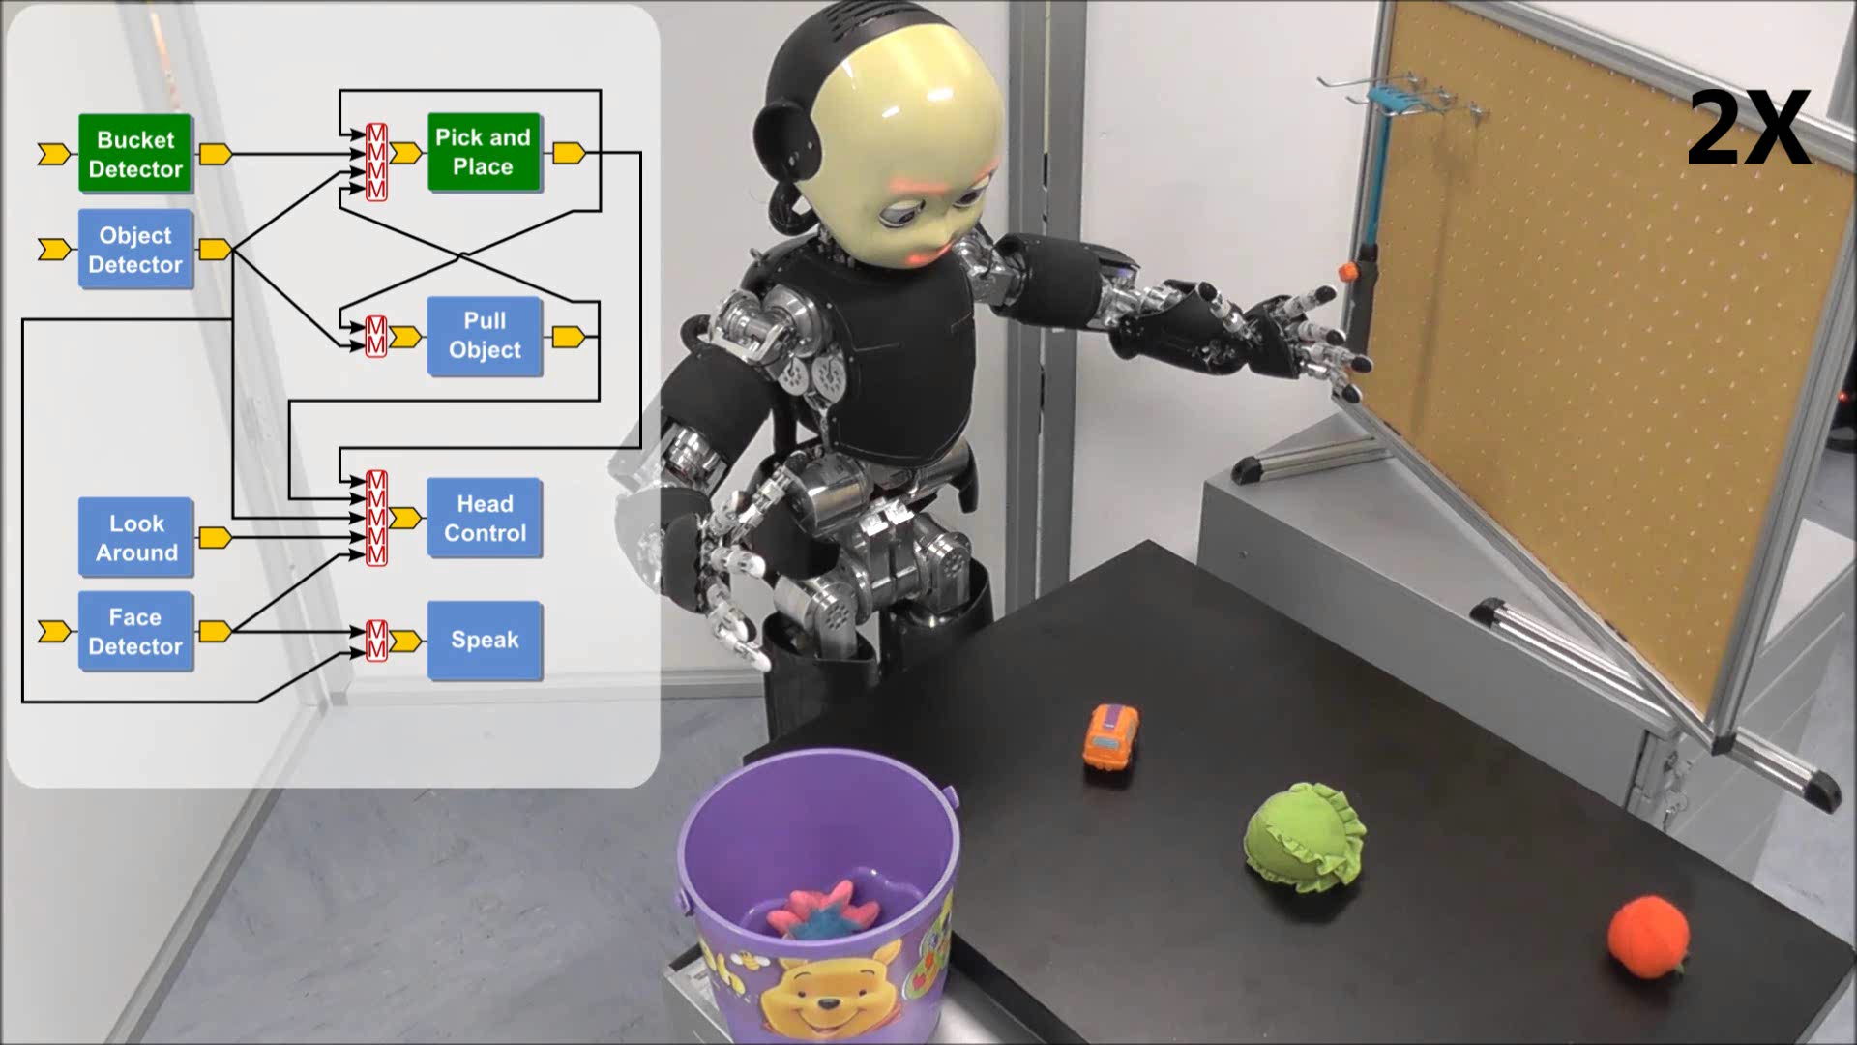
Paikan, A., et al., Enhancing software module reusability using port plug-ins: an experiment with the iCub robot, IROS 2014.

Slide 53
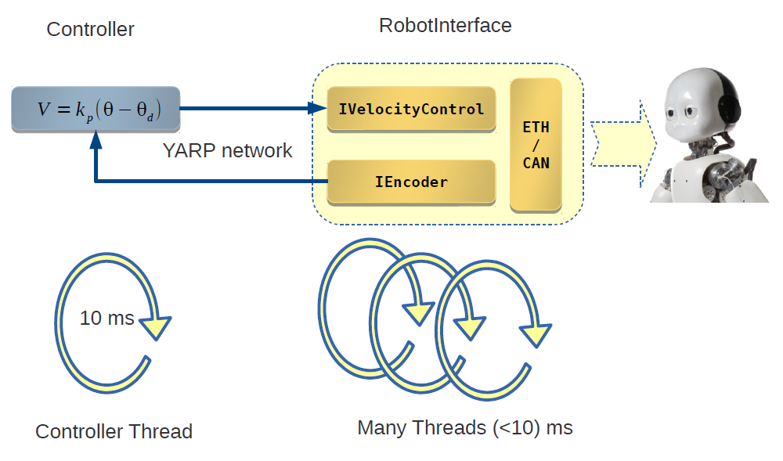


Improving determinism

Slide 54
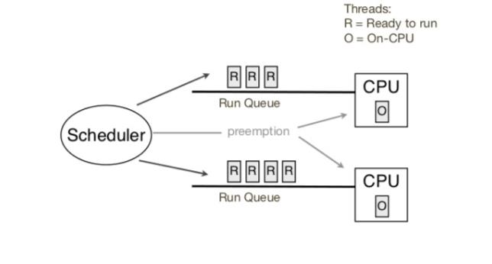


Threads and scheduling, quick overview
Issues:
Scheduling and interrupt latency
Certain operations may be blocking i.e. not preemtable (usually system calls)
System calls: file management, process management, I/O, memory requests, communication (shared memory), error handling

Slide 55
Which RT solution
Standard Linux
Linux with RT patch
Xenomai/RTAI

Slide 56

The latency of a Linux thread with the highest priority (period 1ms)
(period: 1ms, PC104 / 1Ghz )
Thread latency in Linux-pae-3.2.0 (SCHED_FIFO)
Notes:
During the experiment, system was overloaded by:
4 processes, each calculates the square root of a random number
4 processes, each flushes data buffered in memory to disk (sync()).
4 processes to contentiously allocate and release memory
4 process writing to hard drive (write())
Thread scheduled with 1khz
PC104, Dual Core 1.0GHz
Linux Debian Wheezy (7.0)
Different kernel:
Kernel pae-3.2.0
Kernel preemption-3.2.0
Kernel Xenomai-3.5.7

Slide 57

The latency of a Linux thread with preemption patch (period: 1ms, PC104 / 1Ghz )
Thread latency in Linux-rt-3.2.0

Slide 58

The latency of a Linux thread with Xenomai patch (period: 1ms, PC104 / 1Ghz )
Thread latency in Linux-xenomai-3.5.7

Slide 59



Which RT solution?
Standard Linux
Linux with RT patch
Xenomai/RTAI
After preliminary evaluation we decided to adopt Linux with RT patch

Slide 60

HOST1
Robot
Standard YARP
With priority

Slide 61

System under heavy load

Slide 62

After adjusting thread priorities

Slide 63
HOST1
Robot
switch
Standard YARP
With priority

Slide 64

HOST1
20% load
Robot
switch
Standard YARP
With priority

Slide 65
Bottlenecks
Robot
HOST1
HOST2
switch

Slide 66

Approach: improve determinism by increasing thread priorities and reducing network bottlenecks using QoS
> prop sched policy 1 priority 30
> prop set qos priority HIGH
Paikan et al. accepted IROS 2015

Slide 67


20%/70% load
HOST1
Robot
switch
Standard YARP (20%)
With priority (20%)
Standard YARP (70%)
With priority (70%)

Slide 68


20%/70% load
HOST1
Robot
switch

Slide 69


HOST1
Robot
20%/70% load
HOST2
switch

Slide 70
References
Ali Paikan, Silvio Traversaro, Francesco Nori and Lorenzo Natale, "A Generic Testing Framework for Test Driven Development of Robotic Systems", In Lecture Notes in Computer Science (MESAS15), Springer, pp. , 2015
Paikan, A., Domenichelli, D., and Natale, L., Communication channel prioritization in a publish-subscribe architecture, in Proc. Software Engineering and Architectures for Realtime Interactive Systems Workshop, Arles, France, 2015.
Paikan, A., Tikhanoff, V., Metta, G., and Natale, L., Enhancing software module reusability using port plug-ins: an experiment with the iCub robot, in Proc. IEEE/RSJ International Conference on Intelligent Robots and Systems, Chicago, Illinois, 2014.
Fitzpatrick, P., Ceseracciu, E., Domenichelli, D., Paikan, A., Metta, G., and Natale, L., A middle way for robotics middleware, Journal of Software Engineering for Robotics, vol. 5, no. 2, pp. 42-49, 2014.
Paikan, A., Fitzpatrick, P., Metta, G., and Natale, L., Data Flow Port's Monitoring and Arbitration, Journal of Software Engineering for Robotics, vol. 5, no. 1, pp. 80-88, 2014
Metta, G., Fitzpatrick, P., Natale, L., YARP: Yet Another Robot Platform, International Journal of Advanced Robotics Systems, special issue on Software Development and Integration in Robotics, Volume 3, Issue 1, pp. 43-48, March 2006
Patrick Th. Eugster, Pascal A. Felber, Rachid Guerraoui, and Anne-Marie Kermarrec. 2003. The many faces of publish/subscribe. ACM Comput. Surv. 35, 2 (June 2003), 114-131.
David, B. Stewart, Richard, A. Volpe, Pradeep, K. Khosla, Design of Dynamically Reconfigurable Real-Time Software Using Port-Based Objects, IEEE Trans. On Software Engineering, 23(12), 1997
Dušan Bálek, František Plášil, Software Connectors and Their Role in Component Deployment, New Developments in Distributed Applications and Interoperable Systems, 70, 2002, pp. 69-84.
Farhad Arbab: Reo: a channel-based coordination model for component composition. Mathematical Structures in Computer Science 14(3):329--366, 2004.

